Slide 1


Slide 2
What is it?
Sahi is a free open source test automation tool for web applications.
A free version provides key testing functionality with a payed version giving extended features for companies.

Slide 3
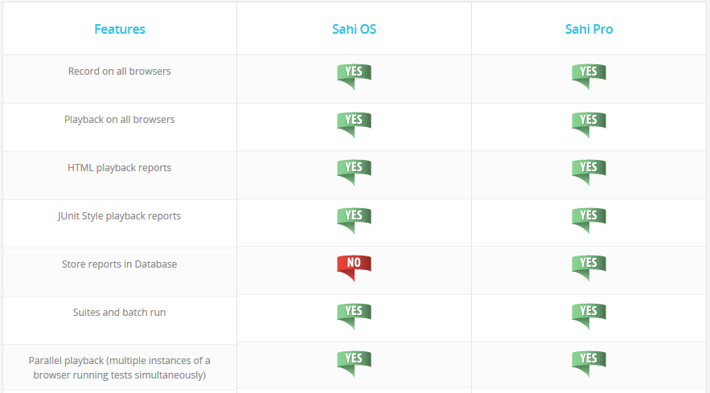
What is it?

Slide 4
What is it?
Currently a single user licence can be purchased for $695 per year with percentage discounts for groups. Other payed features are as follows:
Distribute tests across machines
Anchor Button on Controller to easily establish “near” and “in” relations
View recorded steps in Controller
Script Editor to easily create functions
Excel Framework
Custom report generation
Take Snapshots
Side by Side Compare Logs
Flex automation
Automatically accept SSL certificates
Ability to build repository of HTML Elements while recording

Slide 5
What is it?
Similar to another testing tool called selenium, Sahi automates the behaviour of a web browser through user events like clicking and typing in some text.
The tool can then check the data in the website to make sure that the outcome of the actions is as expected through assertions.

Slide 6
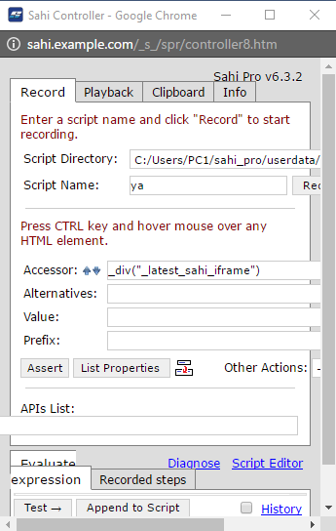
What is it?
The key functionality of simulating a user’s actions and recording the actions.
This works well with an emphasis on functionality rather than on a good looking resizable interface.
The interface of Sahi in the browser will become skewed for example if it is resized.

Slide 7
What is it?
Selenium is a much more popular testing tool of this type with a larger community for support.
Users have reported that Sahi performs faster and with less problems for browsers in particular IE.
The advantage of using Sahi is in not having to explicitly install a browser driver plugin.
Sahi provides less free feature compared to its competitors, which is not a fair comparison of usability and functionality.

Slide 8
What is it?
The installation in Windows is straight forward. After downloading the software, a licence key is emailed, to be entered when it is first run.
Sahi runs as a Java application that opens a private browsing window for testing.

Slide 9
How Does it Work?
Sahi is best suited for multi-browser testing that contain AJAX and dynamic content. Sahi can run on any browser that supports JavaScript.
AJAX stands for Asynchronous JavaScript and XML. AJAX is a new technique for creating interactive, dynamic web applications using XML, HTML, CSS and JavaScript.

Slide 10
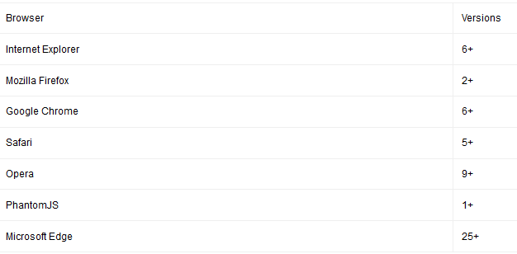
How Does it Work?

Slide 11
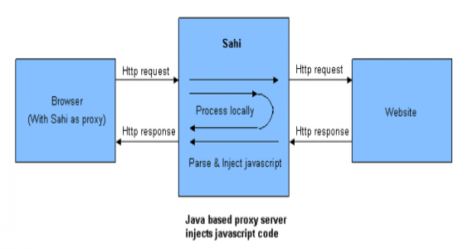
How Does it Work?
Sahi’s core features include the Sahi proxy and the JavaScript Engine.

Slide 12
How Does it Work?
HTML responses that pass through the proxy are amended so that JavaScript is injected at the start and the end of the response.
This process then allows the chosen browser to record and playback scripts and talk back to the proxy when needed.
Basically, the process above keeps track of all the communication occurring which can be later referred to if needed by the browser.

Slide 13
How Does it Work?
The scripts can be written in any text editor!
So scripts are all based on JavaScript but each script is parsed by Sahi i.e. some modifications added and script saved as .SAH file.
Using these scripts we can write anything that JavaScript is capable of as Sahi inherits every possibility from JavaScript e.g. functions.

Slide 14
How Does it Work?
The user can also add assertions, which are added to the script.
Assertions are used for verification.
This is where the user specifies which path or what should be the correct outcome.

Slide 15
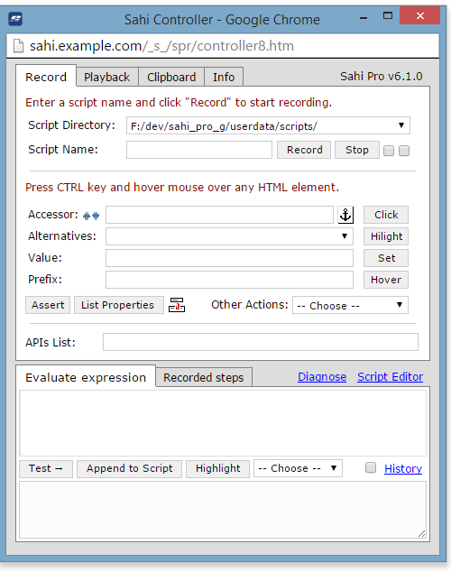
How Does it Work?

Slide 16
How Does it Work?
Step by step execution;
Record actions on the webpage
Modify script adding assertions, functions etc.
Stop recording. Script saved.
Run playback of the script
Sahi generates a log which displays some useful information along with either pass or fail of each action.

Slide 17
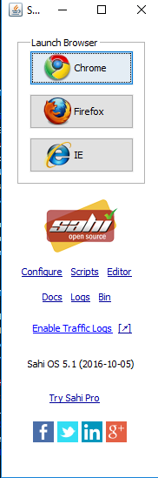
Mini-Exercise Sahi’s Sample Application
Sahi Overview (Main Points)
Launch Browser – Opens a new browser of choice with a proxy enabled.
Configure – Opens the config menu in a browser window. New browsers can be added as well as the option to return a 404error for certain sites accessed.
Scripts – Opens the folder where all user recorded scripts are saved.
Editor(Pro version only) – Opens the SAHI editor.
Docs – Opens the SAHI documentation site.
Logs – View the results from all tests conducted.

Slide 18
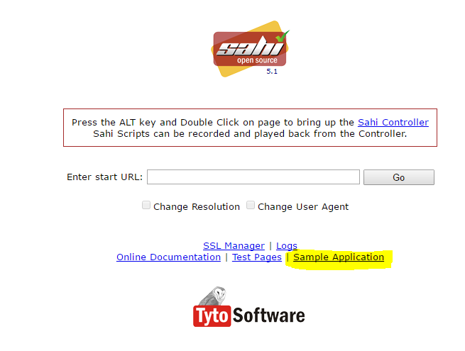
Exercise – Record a test script using the Sample site
Step One: Launch a browser through SAHI and click the sample application link.

Slide 19
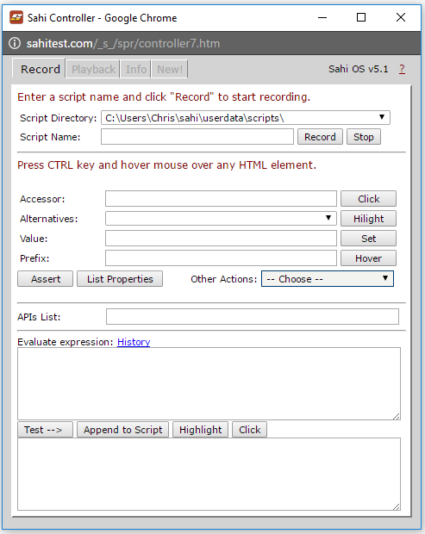
To bring up to controller for SAHI hold the alt key and double click the page.
Once the controller is opened Enter a Script name and press record.
The controller is now listening for actions to add to the script.

Slide 20
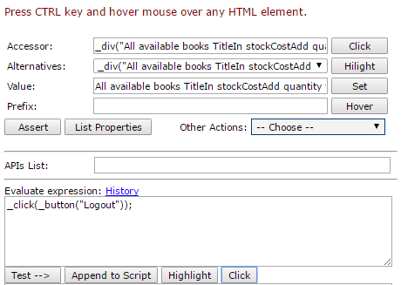
View an elements properties by holding the control key and hovering over the element

Slide 21
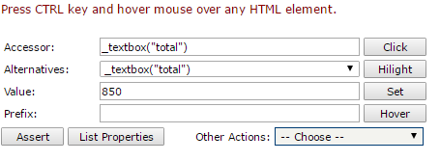
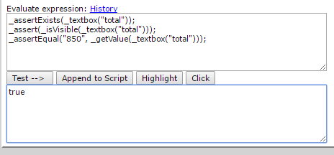
Use the provided username/password to login (test/secret)
Once cart screen opens add a few items and press the add button
To assert a value hover over the Total textbox holding the control key
The following should appear inside the controller, Press the Assert Button and the following should appear on the controller window.

Slide 22
The syntax should be auto generated from the assert button but this section of the controller can also take user input to amend to the script.
To test the expression press the test button and “True” should be outputted in the box below or a failure message if incorrect.
TO add the expression to the script press amend to script.
Now we have our script finished press the stop recoding button.

Slide 23
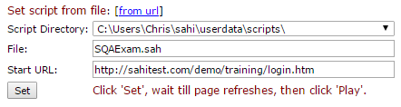
Playback recorded scripts
To run a test script open the playback tab in the controller and enter the file name and the starting URL for the test and press the set button. The page we have been recording on should refresh to the starting url.

Slide 24
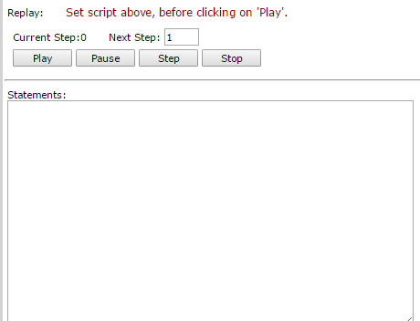
Play – Runs the entire script.
Pause – pauses the script when running.
Step – Step through actions one by one. Useful for debugging scripts as well as failures.
Stop – Stops the script from running.
To refresh and rerun a script simply press the set button again to refresh the page.

Slide 25
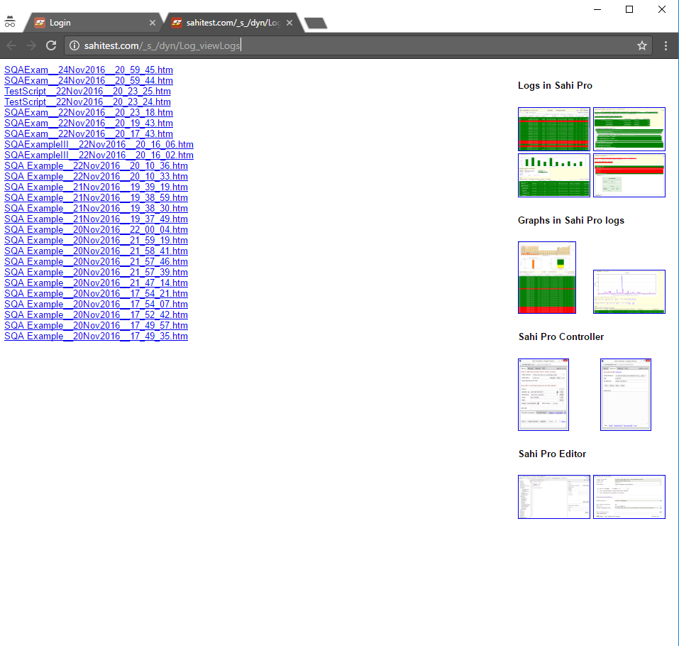
View Test Logs
To view the logs either click the link at the bottom of the controller or the link from the SAHI application itself. A new browser tab will open.(Ordered By Date)

Slide 26
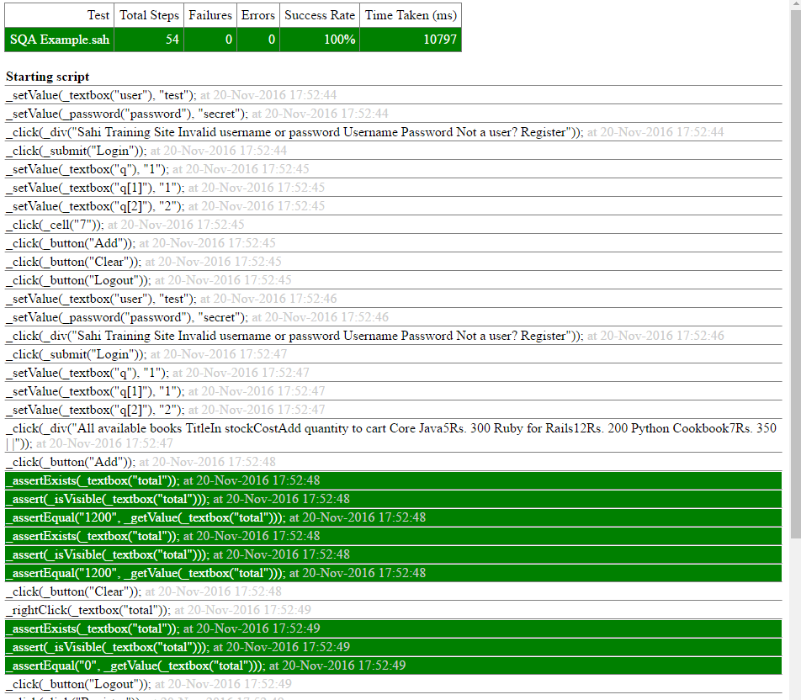
The log is just a record of the test that ran with metrics for success rate, Failures, Errors and time taken to run the test.
White – Actions performed
Green – Assertions(Usually Boolean result)

Slide 27
How does it apply to us?
SAHI is a really easy and powerful testing tool with support for a wide variety of browsers and great support for mobile over a local connection.
Scripts are written in native JavaScript syntax which reduces the learning curve by a lot for those who have experience in the language and the frameworks APIS are really easy to use.
Has support for complex use cases through JavaScript functions.
Has great Jenkins integration for test automation (Distributed testing on pro version could be done with the open source version through Jenkins)

Slide 28
Strengths
Easy to set up –no additional tools are required .
Open source tool therefore it is available to everyone.
Efficiency- Sahi handles the repetitive, time consuming tests and it allows the team to focus on the tricky ones. This allows teams to be more efficient therefore saving time and also generating ROI.
Consistent Platform : Sahi has the ability to run on all browsers. This reduces the number of errors in the testing scenario by going through pre-recorded instructions.
Sahi scripts are fast to create and very easy to maintain
Reporting- Inbuilt HTML reports with click through to relevant portion of script.
Sahi is simple for new non-programmer users to get started

Slide 29
Weaknesses
Support for multiple languages: SAHI uses Javascript as its base language. Currently SAHI does not let you create your test cases in other language.
Sahi application runs separate from the record window.
Browser has to be configured to work with a proxy.

Slide 30
Questions?

Slide 31
Team Members
Aleksander Zoric
Liranda Krasniqi
Chris O’Brien
James McGarr

